Slide 1
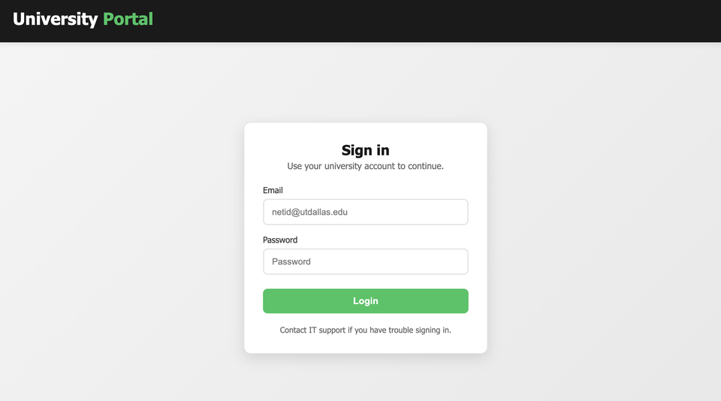
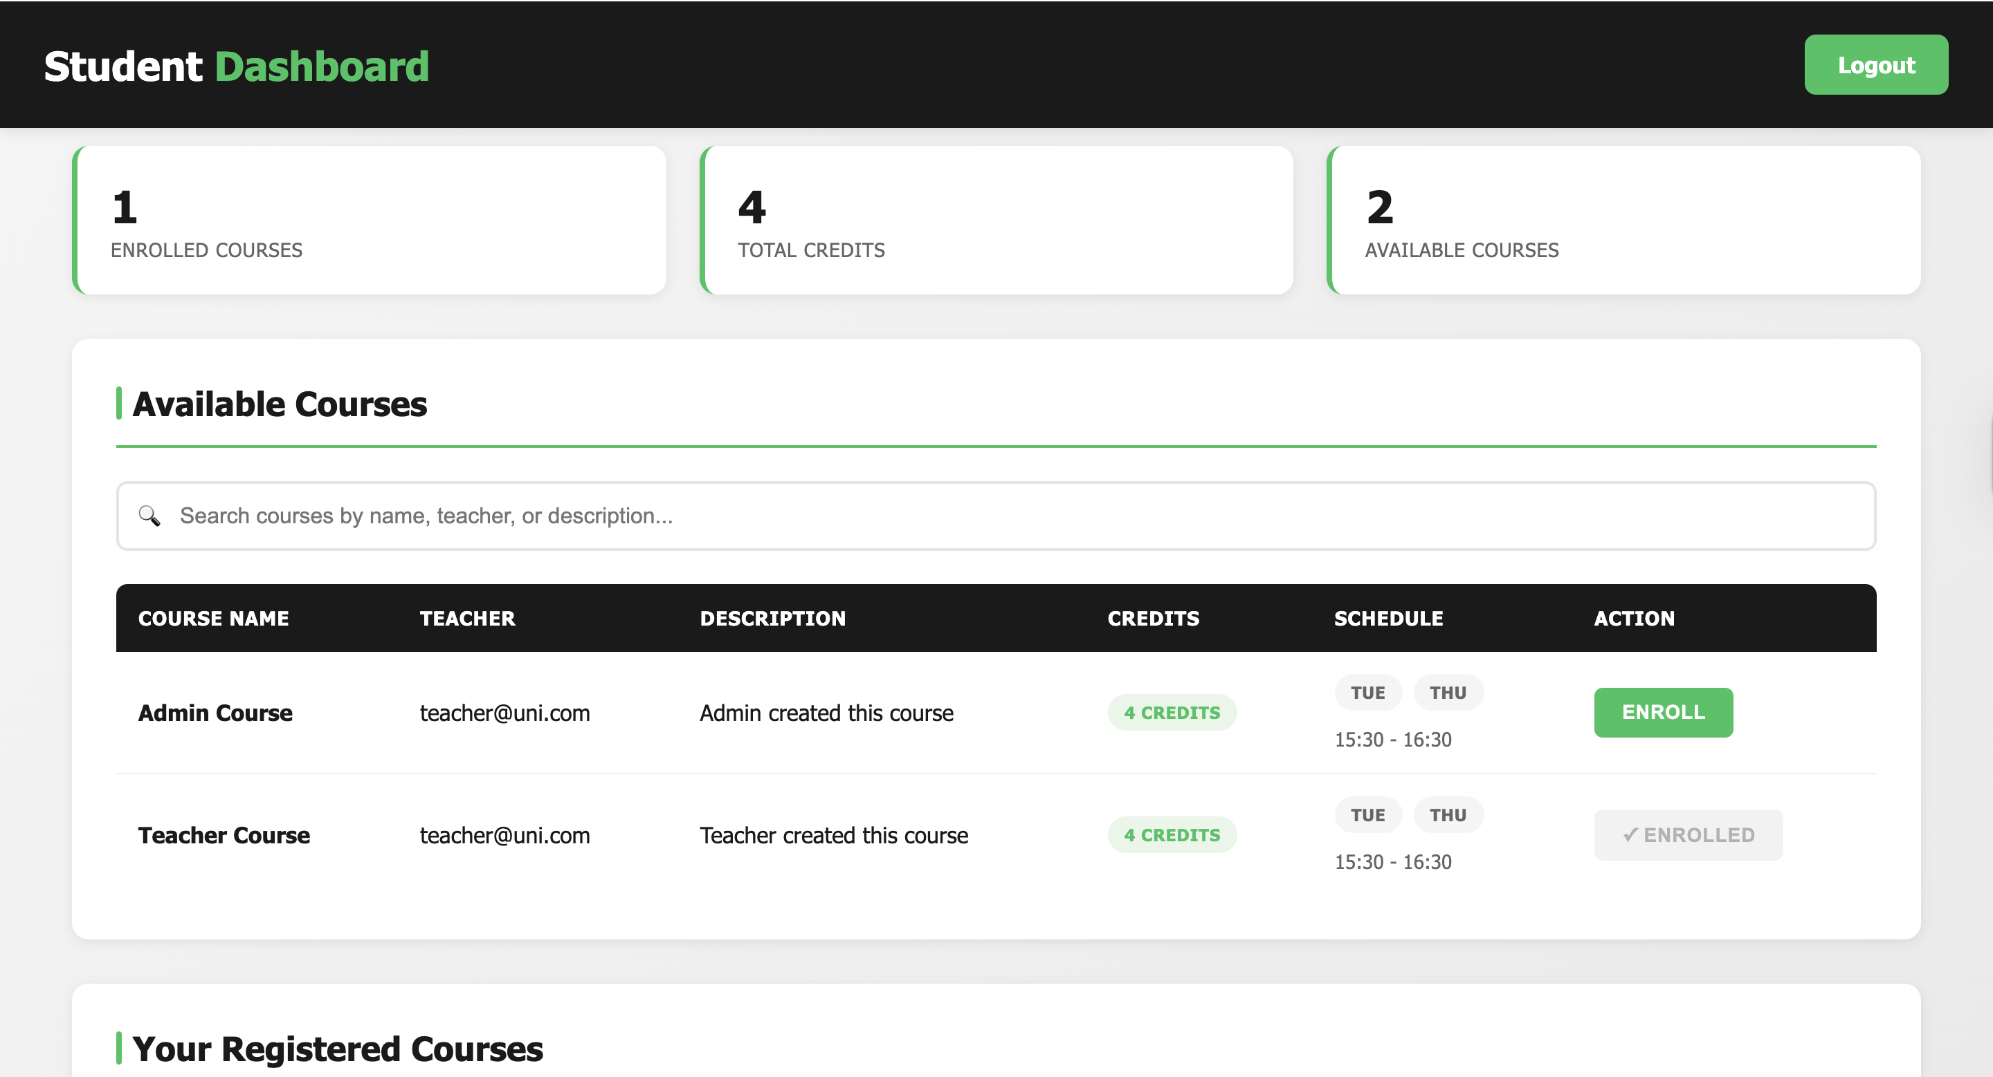
CS 3354 Team 3 Group Project: University Portal​
Made By Team 3: Anthony Dye, Kenton Le, Mason Powers,
Jesus Mercado, Marcos Benitez

Slide 2
Overview
Our system is a web-based class registration platform for students, professors, and administrators.
Problem solved: replaces confusing / limited registration processes with a clearer, more reliable, and automated system.

Slide 3
Key Features
Secure login + authentication for all user types
Students - search, filter, add/drop classes, manage schedules, and joinwaitlists.
Professors - post courses, edit information, and upload syllabi.
Administrators - override actions, manage accounts, and control registration windows.

Slide 4
Development Approach
We use Agile because the system is not life-critical and benefits from fast iteration.
2 week sprints allowed us to build core features first, then expand as time allowed.
Agile supports changing requirements as we understood the system better.
Continuous testing ensured each sprint produced a working piece of the final application.

Slide 5
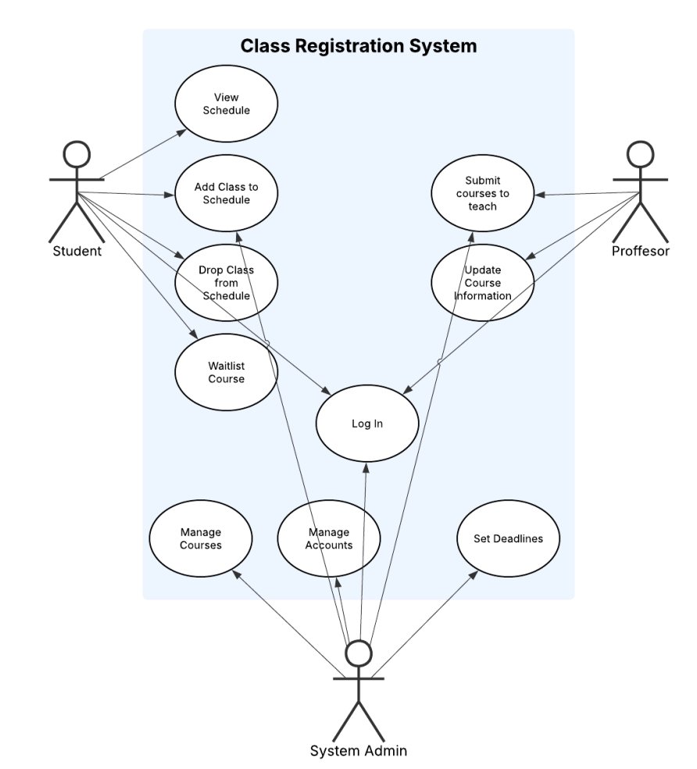
Requirements Guided Everything
It all started at login. Each functional requirement from Deliverable I directly maps to a use-case in our diagram
The diagram visually separates the three major user roles—students, professors, and system administrators—matching the stakeholder requirements we identified The central "Log In" use-case ties back to our authentication requirements and drives the flow into each role-specific subsystem

Slide 6
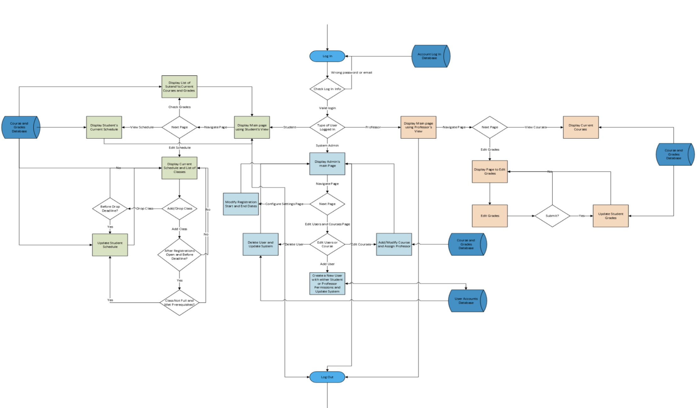

Slide 7
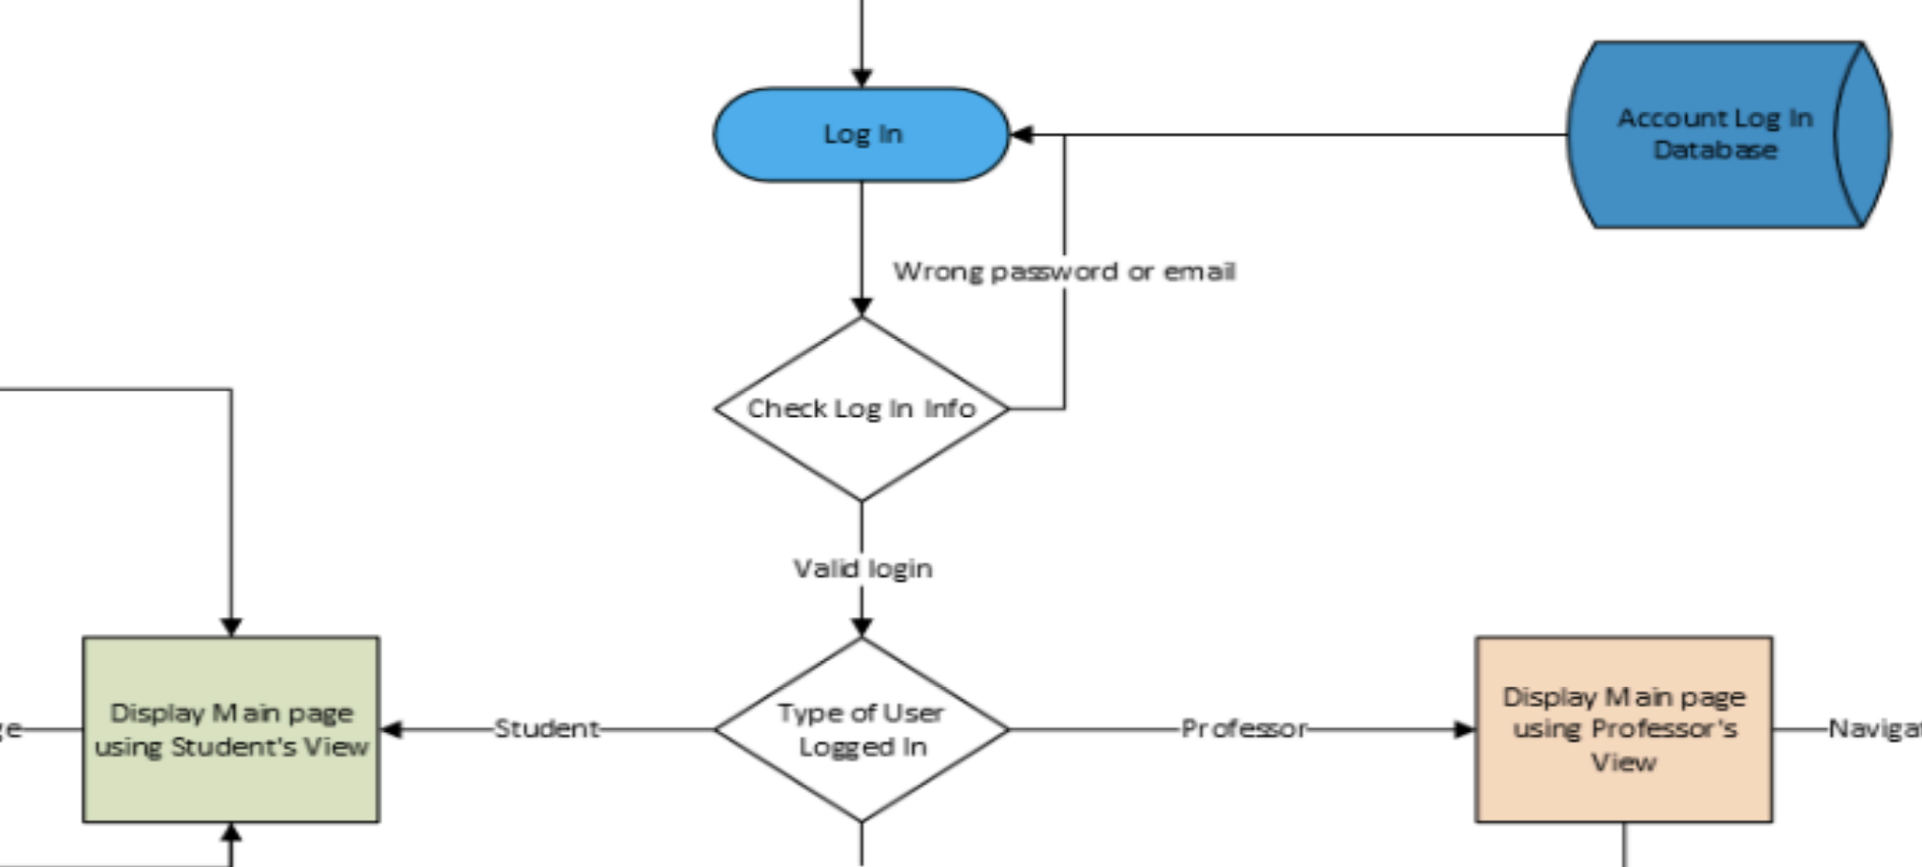
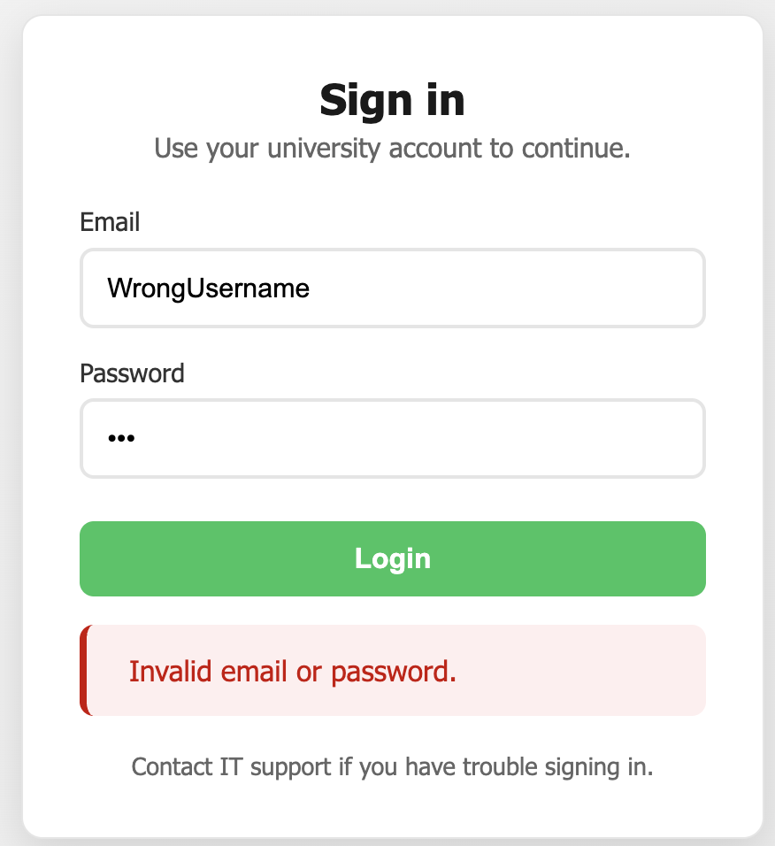
Process Model
Our activity diagram from Deliverable II shows how each requirement from Deliverable I transforms into actual system behavior and user flow
This process model allowed us to validate that every requirement had a clear path in the system before building the architecture
Verifiability – can you test it?
Comprehensibility – is it clear?
Traceability – do you know where it came from?
Adaptability – can it be changed later?

Slide 8
Development Organization
Three main phases: planning, development, and testing
Divided development phase into two phases
Sprint 1: Focused on building main features and basic UI layout
Sprint 2: Focused on refining UI and connection the frontend and backend
Met every two weeks to talk about each others progress and plan tasks

Slide 9
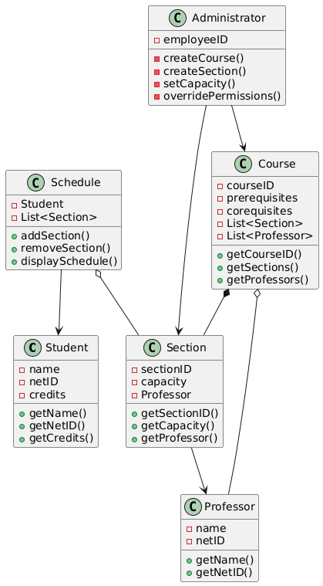
Planning Phase
Agreeing on specific features and requirements
Overall system architecture
Deciding on how the system perform and what it must do

Slide 10
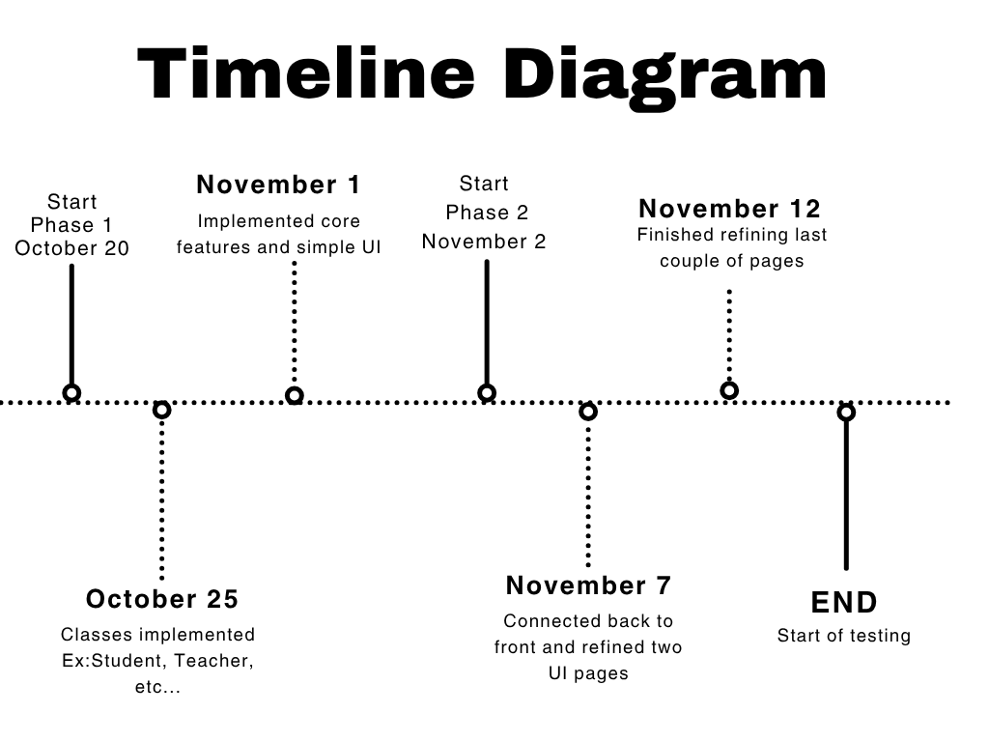
Development

Slide 11
Testing
Testing each implemented feature
Debugging UI feature and refining final touches
Checking data flow
Automated testing

Slide 12
Teamwork Reflection
Challenges
Solutions
UI design and organization
Code organization and implementation
Understanding how the overall system works
Divide work evenly
Communicating with one another
Keeping each other on check

Slide 13
Implementation Summary
Used Spring Boot framework – Allows us to build project almost entirely in Java, Easy to use, Quick implementation. Spring Boot supports REST APIs and MySQL database
GitHub found that our project was roughly 54% Java, and 46% HTML, CSS, and JavaScript
Most of our group used IntelliJ for our IDEs and obviously Git and GitHub for version control

Slide 14

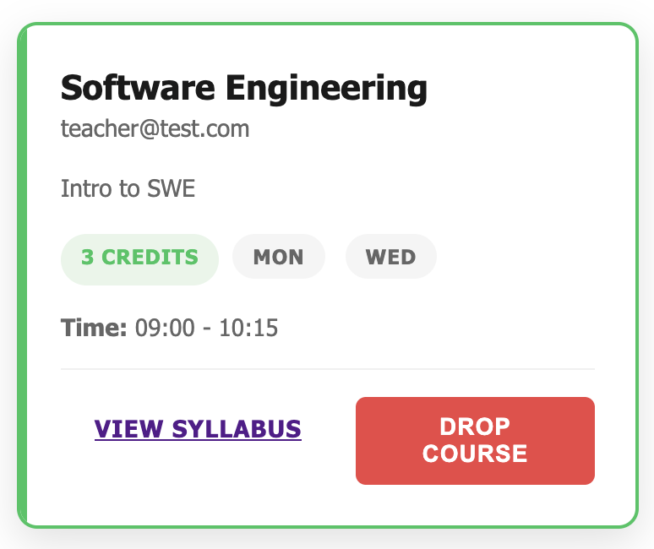
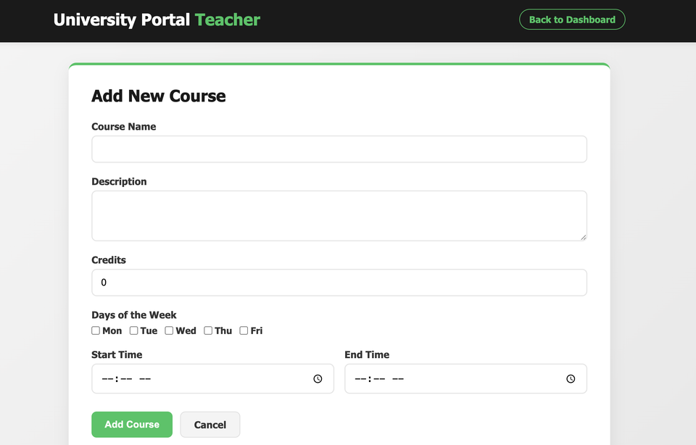
Some Main Requirements We Developed Include :
Allowing users to log in to the system using their unique email and passwords (FR#1)
Allowing students to add and drop classes to their schedule as long as they do not go over the max credit limit (FR#5, 7, 8)
Allowing professors to create and delete courses for students to register for and include basic information about the course (FR#2, 3)
Allowing system administrators to perform these tasks on behalf of students and professors (FR#13, 14).

Slide 15
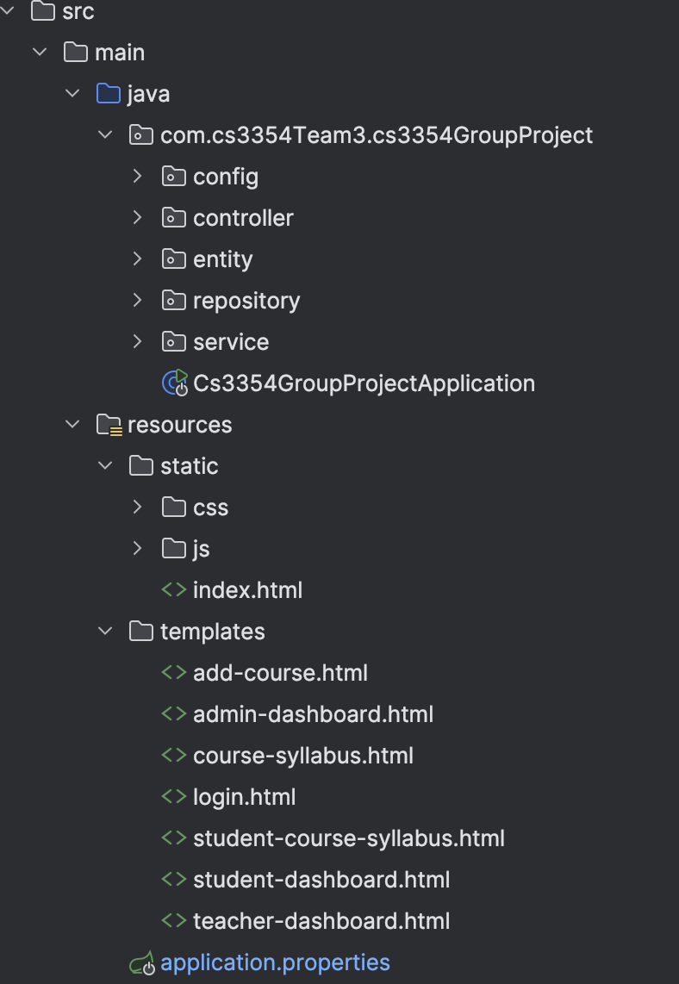
Implementation Design Choices
Used Class hierarchy of Users to promote reusability
Used MVC pattern where most of our user and repository files serve as the model, most of our front-end HTML files serve as the view, and most of the files ending in controller serve as the controller. This promotes modularity.

Slide 16
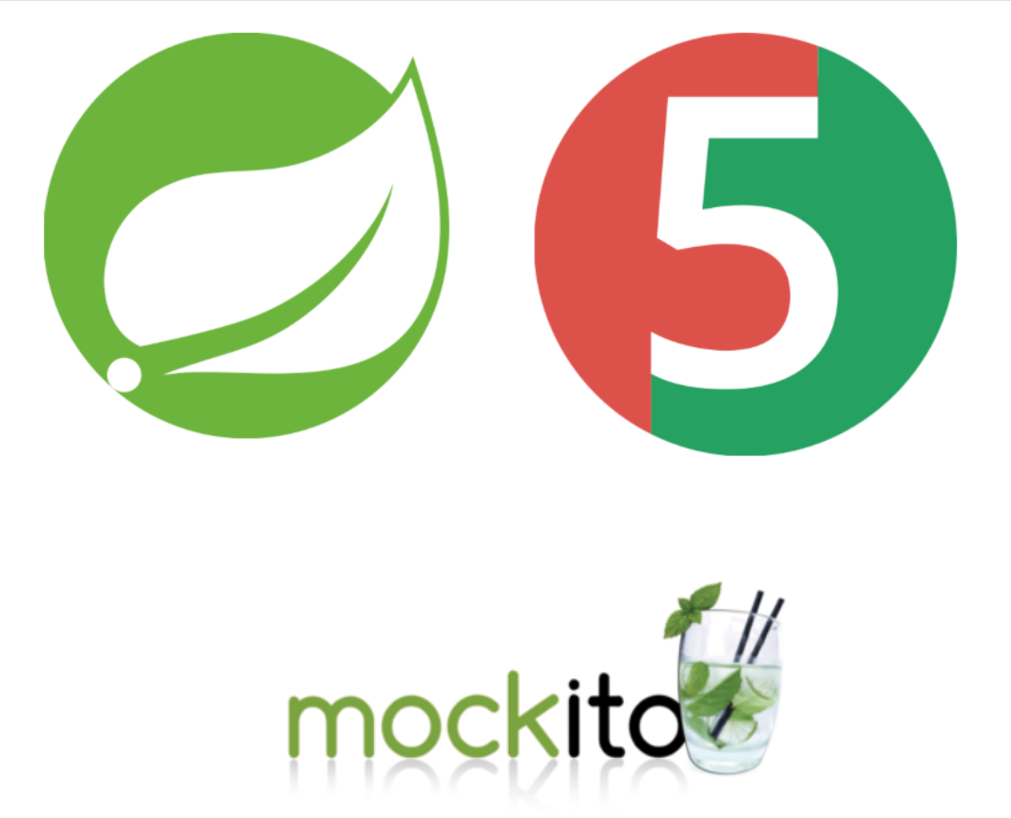


Automated Testing Strategy
ChatGPT and Gemini – test generation
JUnit – primary framework
Mockito – creation of "mock" objects to allow isolated testing
Spring boot test –for integration tests using MockMVC

Slide 17
3-Tiered Approach
Unit Tests | Integration Tests | System Tests
SyllabusServiceTest CustomUserDetailsServiceTest AdminControllerTest TeacherControllerTest StudentControllerTest LoginControllerTest | RepositoryIntegrationTest SecurityConfigTest | StudentE2ETest StudentFunctionalTest*
*Test driven approach for remaining functional requirements

Slide 18
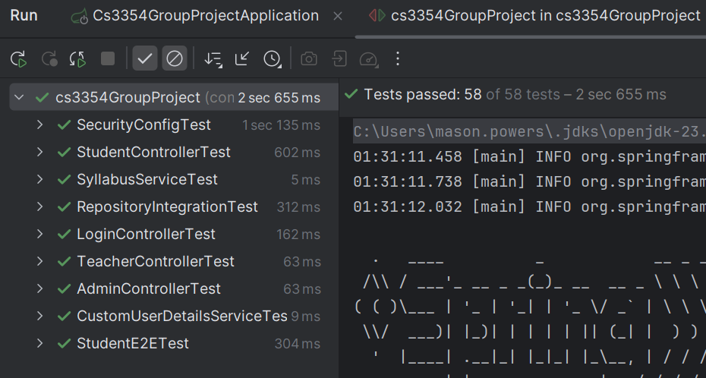
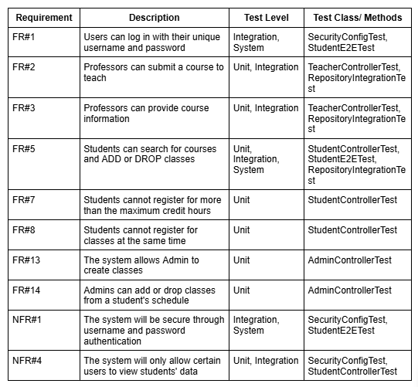
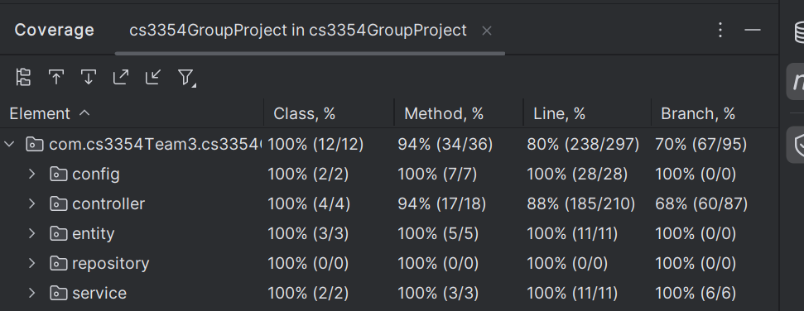
Coverage and Results

Slide 19
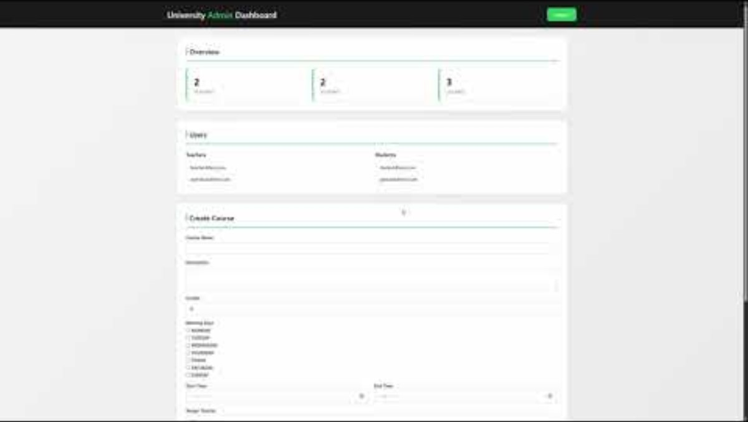

Slide 20
Reflection
Major Challenges
Setting up to run the system
Lack of experience in web development and database systems
Solutions
Trial and error
Online research
Key Lessons
Development often takes longer than planned
Better to start small with ideas
Improvements
Add a schedule generator
Notes:
Challenges we faced are setting up the system, and the fact that we lacked experience in web development and database systems.
We overcame those challenges through trial and error, as well as with online research.
Key lessons to take away are that development often takes longer than planned for, so teams should account for changes and problems.
Also, it’s better to start small, because that will lay the groundwork for everybody to know what they are working with.
An improvement we could’ve made is implementing a schedule generator that outputs all permutations of selected sections, like Schedule Planner.

